Slide 1
Ethics in Information Technology, Fifth Edition
Chapter 3 (Part-I)
Computer and Internet Crime

Slide 2
Objectives
As you read this chapter, consider the following questions:
Part - I
What key trade-offs and ethical issues are associated with the safeguarding of data and information systems?
Why has there been a dramatic increase in the number of computer-related security incidents in recent years?
What are the most common types of computer security attacks?

Slide 3
Objectives (cont’d.)
Part - II
Who are the primary perpetrators(criminals) of computer crime, and what are their objectives?
What are the key elements of a multilayer process for managing security vulnerabilities based on the concept of reasonable assurance?
Part - III
What actions must be taken in response to a security incident?
What is computer forensics, and what role does it play in responding to a computer incident?

Slide 4
IT Security Incidents: A Major Concern
Security of information technology is of utmost importance
Safeguard:
Confidential business data
Private customer and employee data
Protect against malicious acts of theft or disruption(disorder)
Balance against other business needs and issues
Number of IT-related security incidents is increasing around the world

Slide 5
Why Computer Incidents Are So Dominant
Increasing complexity increases vulnerability
Computing environment is enormously complex
Continues to increase in complexity
Number of entry points expands continuously
Cloud computing and virtualization software
Higher computer user expectations
Computer help desks under intense pressure
Forget to verify users’ IDs or check authorizations
Computer users share login IDs and passwords

Slide 6
Why Computer Incidents Are So Prevalent(Dominant ) (cont’d.)
Expanding/changing systems equal new risks
Network era
Personal computers connect to networks with millions of other computers
All capable of sharing information
Information technology
Ubiquitous(global)
Necessary tool for organizations to achieve goals
Increasingly difficult to match pace of technological change

Slide 7
Why Computer Incidents Are So Prevalent (cont’d.)
Increased reliance on commercial software with known vulnerabilities
Exploit
Attack on information system
Takes advantage of system vulnerability
Due to poor system design or implementation
Patch
“Fix” to eliminate the problem
Users are responsible for obtaining and installing
Delays expose users to security breaches

Slide 8
Why Computer Incidents Are So Prevalent (cont’d.)
Zero-day attack
Before a vulnerability is discovered or fixed
Attack that occurs on the same day a weakness is discovered in software.
U.S. companies rely on commercial software with known vulnerabilities

Slide 9
Types of Exploits
Computers as well as smartphones can be target
Types of attacks
Virus
Worm(a type of malware that can automatically propagate or self-replicate without human interaction, enabling its spread to other computers across a network)
Trojan horse(A Trojan Horse Virus is a type of malware that downloads onto a computer disguised as a legitimate program)
Distributed denial of service
Rootkit(What is rootkit? A rootkit is software used by cybercriminals to gain control over a target computer or network)
Spam(Spam is any unsolicited communication sent in bulk.)
Phishing (Phishing is a type of social engineering attack often used to steal user data, including login credentials and credit card numbers)

Slide 10
Viruses
Pieces of programming code
Usually disguised as something else
Cause unexpected and undesirable behavior
Often attached to files
Deliver a “payload”
Spread by actions of the “infected” computer user
Infected e-mail document attachments
Downloads of infected programs
Visits to infected Web sites
Understand macro virus
Notes:
Disguised: hidden

Slide 11
Worms
Harmful programs
Reside in active memory of a computer
Duplicate themselves
Can propagate without human intervention
Negative impact of worm attack
Lost data and programs
Lost productivity
Additional effort for IT workers

Slide 12
Trojan Horses
Malicious code hidden inside seemingly harmless programs
Users are tricked into installing them
Delivered via email attachment, downloaded from a Web site, or contracted via a removable media device
Logic bomb
Executes when triggered by certain event

Slide 13
Distributed Denial-of-Service (DDoS) Attacks
Malicious hacker takes over computers on the Internet and causes them to flood a target site with demands for data and other small tasks
The computers that are taken over are called zombies
Botnet is a very large group of such computers
Does not involve a break-in at the target computer
Target machine is busy responding to a stream of automated requests
Legitimate users cannot access target machine

Slide 14
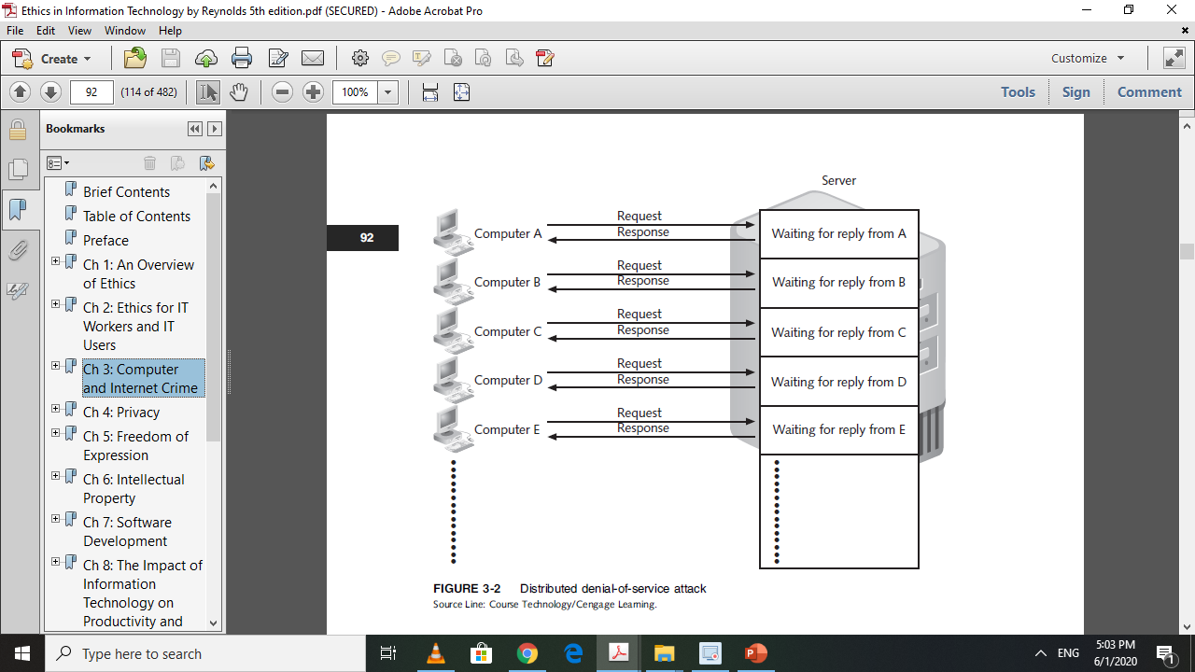

Slide 15
Rootkits
Set of programs that enables its user to gain administrator-level access to a computer without the end user’s consent or knowledge
Attacker can gain full control of the system and even obscure the presence of the rootkit
Fundamental problem in detecting a rootkit is that the operating system currently running cannot be trusted to provide valid test results

Slide 16
Spam
Abuse of email systems to send unsolicited email to large numbers of people
Low-cost commercial advertising for questionable products
Method of marketing also used by many legitimate organizations

Slide 17
Spam (cont’d.)
Completely Automated Public Turing Test to Tell Computers and Humans Apart (CAPTCHA)
Software generates tests that humans can pass but computer programs cannot

Slide 18
Phishing
Act of using email fraudulently to try to get the recipient to reveal personal data
Legitimate-looking emails lead users to bogus Web sites
Spear-phishing
Fraudulent emails to an organization’s employees
Smishing
Phishing via text messages
Vishing
Phishing via voice mail messages

Slide 19
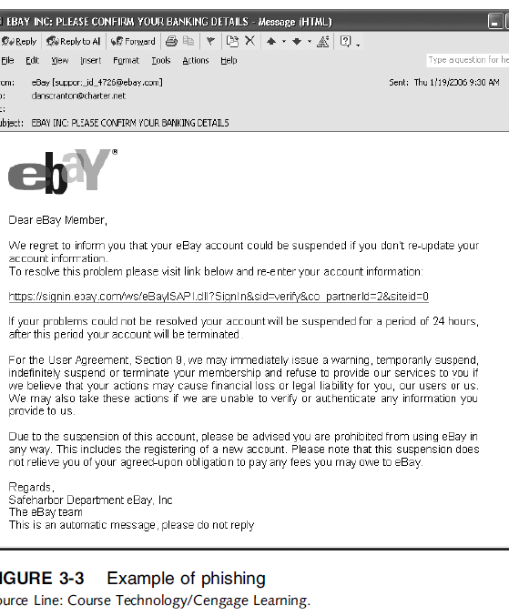
Ethics in Information Technology, Fourth Edition

Slide 20
Assignment:
10 Marks
What is BYOD? Write its advantages and disadvantages. Also explain either it is risky for your company or ignorable. If it’s a threat, which guidelines your will provide to your employees?

Slide 21
Ethics in Information Technology, Fifth Edition
Chapter 3 (Part-III)
Computer and Internet Crime

Slide 22
Recap:
What key trade-offs and ethical issues are associated with the safeguarding of data and information systems?
Why has there been a dramatic increase in the number of computer-related security incidents in recent years?
What are the most common types of computer security attacks?

Slide 23
Types of Perpetrators
Perpetrators include:
Thrill seekers wanting a challenge
Common criminals looking for financial gain
Industrial spies trying to gain an advantage
Terrorists seeking to cause destruction
Different objectives and access to varying resources
Willing to take different levels of risk to accomplish an objective

Slide 24
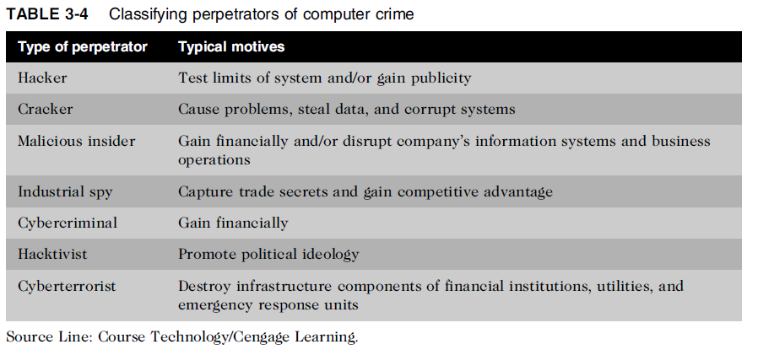
Types of Perpetrators (cont’d.)

Slide 25
Hackers and Crackers
Hackers
Test limitations of systems out of intellectual interest
Some smart and talented
Others inept; termed “lamers” or “script kiddies”
Crackers
Cracking is a form of hacking
Clearly criminal activity

Slide 26
Malicious Insiders
Major security concern for companies
Fraud within an organization is usually due to weaknesses in internal control procedures
Collusion
Cooperation between an employee and an outsider
Insiders are not necessarily employees
Can also be consultants and contractors
Extremely difficult to detect or stop
Authorized to access the very systems they abuse
Negligent insiders have potential to cause damage
Several steps organizations can take to reduce the potential for attacks (see pg97)

Slide 27
Industrial Spies
Use illegal means to obtain trade secrets from competitors
Trade secrets are protected by the Economic Espionage Act of 1996 (discussed in chapter 06)
Competitive intelligence
Uses legal techniques
Gathers information available to the public
Industrial espionage
Uses illegal means
Obtains information not available to the public

Slide 28
Cybercriminals
Hack into corporate computers to steal
Engage in all forms of computer fraud
Chargebacks are disputed transactions
Loss of customer trust has more impact than fraud
To reduce potential for online credit card fraud:
Use encryption technology
Verify the address submitted online against the issuing bank
Request a card verification value (CVV)
Use transaction-risk scoring software

Slide 29
Cybercriminals (cont’d.)
Smart cards
Contain a memory chip
Updated with encrypted data each time card is used
Used widely in Europe
Not widely used in the U.S.

Slide 30
Hacktivists and Cyberterrorists
Hacktivism
Hacking to achieve a political or social goal
Cyberterrorist
Attacks computers or networks in an attempt to threaten or pressure a government in order to advance certain political or social objectives
Seeks to cause harm rather than gather information
Uses techniques that destroy or disrupt services

Slide 31
Ethics in Information Technology, Fifth Edition
Chapter 3 (Part-IV)
Computer and Internet Crime

Slide 32
Recap:
What key trade-offs and ethical issues are associated with the safeguarding of data and information systems?
Why has there been a dramatic increase in the number of computer-related security incidents in recent years?
What are the most common types of computer security attacks?
Who are the primary perpetrators of computer crime, and what are their objectives?
Today’s Topic:
What are the key elements of a multilayer process for managing security vulnerabilities based on the concept of reasonable assurance?

Slide 33
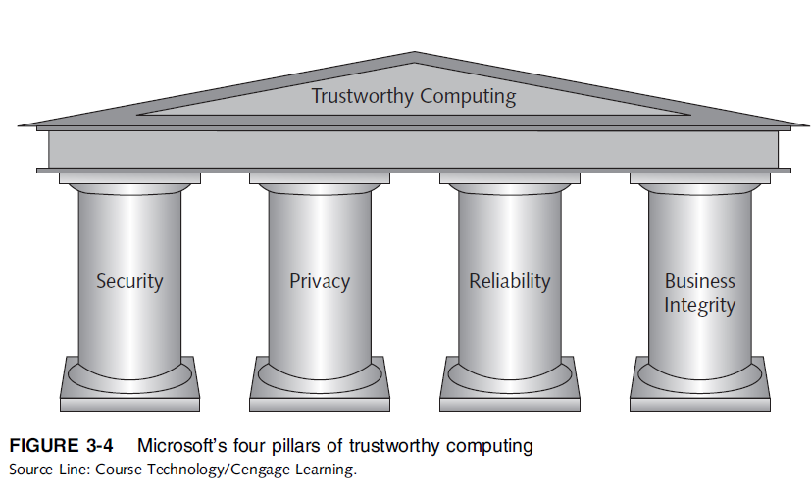
Implementing Trustworthy Computing
Trustworthy computing
Delivers secure, private, and reliable computing
Based on sound business practices

Slide 34
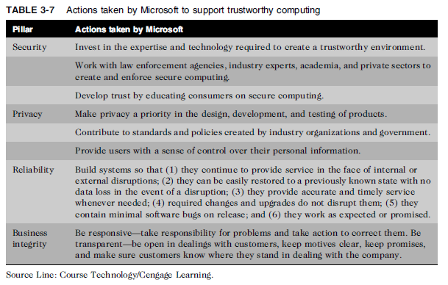
Implementing Trustworthy Computing

Slide 35
Implementing Trustworthy Computing (cont’d.)
Security of any system or network
Combination of technology, policy, and people
Requires a wide range of activities to be effective
Systems must be monitored to detect possible intrusion
Clear reaction plan addresses:
Notification, evidence protection, activity log maintenance, containment, eradication, and recovery

Slide 36
Risk Assessment
Process of assessing security-related risks:
To an organization’s computers and networks
From both internal and external threats
Identifies investments that best protect from most likely and serious threats
Focuses security efforts on areas of highest payoff

Slide 37
Risk Assessment (cont’d.)
Eight-step risk assessment process
#1 Identify assets of most concern
#2 Identify loss events that could occur
#3 Assess likelihood of each potential threat
#4 Determine the impact of each threat
#5 Determine how each threat could be mitigated
#6 Assess feasibility of mitigation options
#7 Perform cost-benefit analysis
#8 Decide which countermeasures to implement

Slide 38
Establishing a Security Policy
A security policy defines:
Organization’s security requirements
Controls and authorizations needed to meet the requirements
Explains responsibilities and expected behavior
Outlines what needs to be done
Not how to do it
Automated system policies should mirror written policies

Slide 39
Establishing a Security Policy (cont’d)
Automated system policies should mirror written policies
Ethical:
Develop culture of trust and integrity.
Information Sensitive Policy:
Classification and securing organization’s information.
Risk Assessment Policy:
Provide authority for information security, develop teams to analyze risk with conducting business.
Personal communication devices and Voice Mail Policy:
Security for personal devices.

Slide 40
Establishing a Security Policy (cont’d.)
Trade-off between:
Ease of use
Increased security
Areas of concern
Email attachments
Wireless devices
VPN uses the Internet to relay communications but maintains privacy through security features
Additional security includes encrypting originating and receiving network addresses

Slide 41
Educating Employees, Contractors, and Part-Time Workers
Educate and motivate users to understand and follow policy
Discuss recent security incidents
Help protect information systems by:
Guarding passwords
Not allowing sharing of passwords
Applying strict access controls to protect data
Reporting all unusual activity
Protecting portable computing and data storage devices

Slide 42
Ethics in Information Technology, Fifth Edition
Chapter 3 (Part-V)
Computer and Internet Crime

Slide 43
Recap:
What key trade-offs and ethical issues are associated with the safeguarding of data and information systems?
Why has there been a dramatic increase in the number of computer-related security incidents in recent years?
What are the most common types of computer security attacks?
Who are the primary perpetrators of computer crime, and what are their objectives?
What are the key elements of a multilayer process for managing security vulnerabilities based on the concept of reasonable assurance?
Today’s Topic:
Prevention & Response

Slide 44
Prevention
Implement a layered security solution
Make computer break-ins harder
Installing a corporate firewall
Limits network access
Intrusion prevention systems
Block viruses, malformed packets, and other threats
Installing antivirus software
Scans for sequence of bytes or virus signature
United States Computer Emergency Readiness Team (US-CERT) serves as clearinghouse

Slide 45
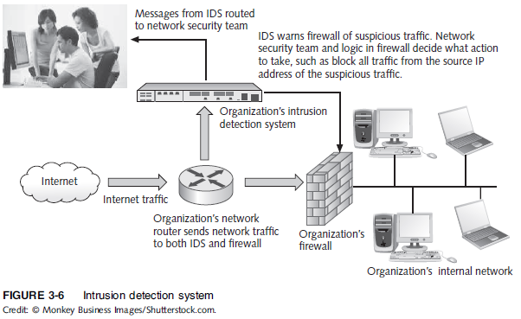
Prevention (cont’d.)

Slide 46
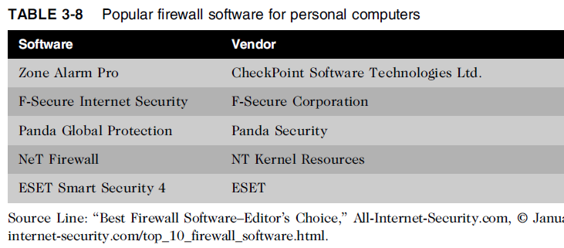
Prevention (cont’d.)

Slide 47
Prevention (Cont’d..)
Knowledge based ID’s:
Contains information about specific attacks.
Watch for attempts such as repeated failed login, downloading file on server etc.
When such attempts are detected, trigger the alarm.
Behavior based ID’s:
Keeps information about normal behavior of user and system.
Detect by comparing current activity and normal behavior.
On detection of dissimilarity, alarm the trigger.
Unusual traffic on odd hours.
HR user attempting to access file of Finance department etc.

Slide 48
Prevention (cont’d.)
Safeguards against attacks by malicious insiders
Departing employees and contractors
Promptly delete computer accounts, login IDs, and passwords
Carefully define employee roles and separate key responsibilities
Create roles and user accounts to limit authority

Slide 49
Prevention (cont’d.)
Defending against cyberterrorism
Department of Homeland Security and its National Cyber Security Division (NCSD) is a resource
Builds and maintains a national security cyberspace response system
Implements a cyber-risk management program for protection of critical infrastructure, including banking and finance, water, government operations, and emergency services
Specific targets are Grid satiations, PSTNs, Air Traffic, act to deduce fire/emergency team response etc.

Slide 50
Prevention (cont’d.)
Conduct periodic IT security audits
Evaluate policies and whether they are followed
Review access and levels of authority
Test system safeguards
Information Protection Assessment kit is available from the Computer Security Institute

Slide 51
Detection
Detection systems
Catch intruders in the act
Intrusion detection system
Monitors system/network resources and activities
Notifies the proper authority when it identifies:
Possible intrusions from outside the organization
Misuse from within the organization
Knowledge-based approach
Behavior-based approach

Slide 52
Response
Response plan
Develop well in advance of any incident
Approved by:
Legal department
Senior management
Primary goals
Regain control and limit damage
Not to monitor or catch an intruder
Only 56% have response plan

Slide 53
Response (cont’d.)
Incident notification defines:
Who to notify
Who not to notify
Security experts recommend against releasing specific information about a security compromise in public forums
Document all details of a security incident
All system events
Specific actions taken
All external conversations

Slide 54
Response (cont’d.)
Act quickly to contain an attack
Eradication effort
Collect and log all possible criminal evidence
Verify necessary backups are current and complete
Create new backups
Follow-up
Determine how security was compromised
Prevent it from happening again

Slide 55
Response (cont’d.)
Review
Determine exactly what happened
Evaluate how the organization responded
Weigh carefully the amount of effort required to capture the perpetrator
Consider the potential for negative publicity
Legal precedent
Hold organizations accountable for their own IT security weaknesses

Slide 56
Computer Forensics
Combines elements of law and computer science to identify, collect, examine, and preserve data and preserve its integrity so it is admissible as evidence
Computer forensics investigation requires extensive training and certification and knowledge of laws that apply to gathering of criminal evidence

Slide 57
Summary
Ethical decisions in determining which information systems and data most need protection
Most common computer exploits
Viruses
Worms
Trojan horses
Distributed denial-of-service attacks
Rootkits
Spam
Phishing, spear-fishing, smishing, vishing

Slide 58
Summary (cont’d.)
Perpetrators include:
Hackers
Crackers
Malicious insider
Industrial spies
Cybercriminals
Hacktivist
Cyberterrorists

Slide 59
Summary (cont’d.)
Must implement multilayer process for managing security vulnerabilities, including:
Assessment of threats
Identifying actions to address vulnerabilities
User education
IT must lead the effort to implement:
Security policies and procedures
Hardware and software to prevent security breaches
Computer forensics is key to fighting computer crime in a court of law

